Slide 1
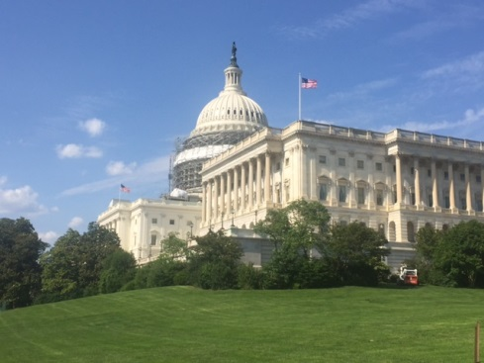
2020 Congressional Landscape
Susan Zook, Founder
Mason Street Consulting
Travis Johnson, Principal
1607 Strategies

Slide 2
Changes, Impeachment and the Congressional Schedule

Slide 3
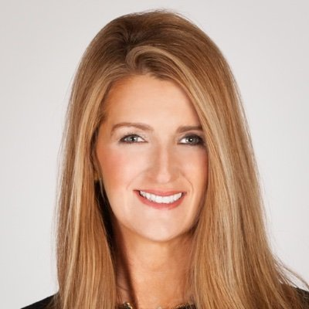
New Senator/Committee Make-Up
New Committee Membership:
  Finance - Sasse (R-NE)
  HELP - ?
  Veteran’s Affairs - ?
  Ethics - ?
  Foreign Relations - ?
Senator-designate Kelly Loeffler (GA-R)

Slide 4

Impeachment Trial
Here are a few things to remember in the run up to a Senate trial on the articles of impeachment poised to pass the House this week, and why the trial isn’t expected to last long:
Any Senator may make a non-debatable motion (51 votes to pass) to enter closed session;
Senators can not speak on the Senate floor during the trial (except for sessions closed to the public);
Senators must be in their desk during the trial, & per Senate rules will start at noon Monday through Saturday until it is finished;
  The 2 hour rule allows committees to meet for two hours without consent when the Senate is in session – this is to allow committees to conduct some limited business, including hearings and executive sessions;
  Also provides a small window for nominations, but means consent will be required to move any legislation during the trial;
Chief Justice of the Senate presides over trial – he can decide the motions (for witnesses or evidence) himself, subject to override by a majority vote, or he can put that question to the body
If Senate does not pass an organizing resolution (as it did prior to Clinton impeachment trial), the Chief Justice has a lot more say in how the trial is conducted
There are 26 rules and a body of precedent governing how the Senate conducts an impeachment trial; last revised in 1986. In 1999, the Senate approved two resolutions modifying existing Senate rules to govern Clinton impeachment trial
Senators can not use phones or iPads while on the Senate floor, in some instances they can pass notes to each other!

Slide 5
Senate Calendar 2020- January?

Slide 6
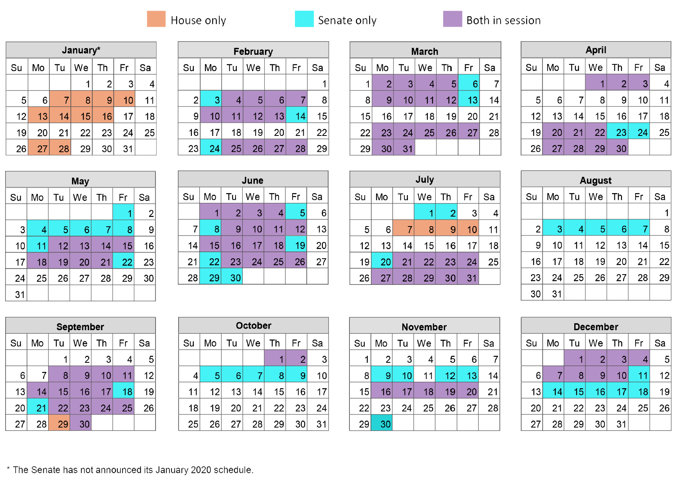
2020 Legislative Calendar

Slide 7

Senate Floor Action in 2020
Judges, more judges, and executive branch nominations
Next Up – Trade/USMCA
Health care “Cliff”- May 22
Appropriations legislation, or more likely, a continuing resolution (CR) to fund the government from the end of September until some time in mid-November
<a href="https://www.freepik.com/free-photos-vectors/business">Business vector created by rawpixel.com - www.freepik.com</a>

Slide 8
2020 Top Issues
Health Care

Slide 9
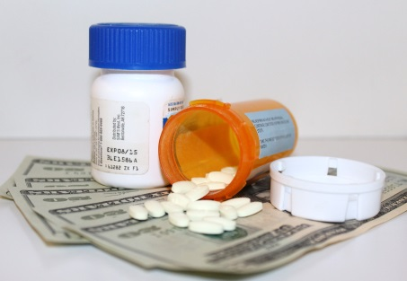
Lowering Cost of Drugs
President and Administration want more “consumer friendly” pricing, models from the international index
Trump has mentioned that lower the cost of drugs is a top if not #1 health care priority
Leader Pelosi passed her own version in the House which will get little Senate attention
Finance Chairman’s package did not get a “win” on his legislation in end of year funding package, largely left out of discussions
Problems:
  Price setting/controls not widely supported by R caucus members, Crapo and others introduced and alternative version of the SFC package
  The controversial nature of these packages puts vulnerable Senators in a hard position
Questions:
  Does the Speaker want to give a victory to Trump during an election year?
  Can a compromise find enough agreement to address this issue in the public as the cost of health care and drugs is one of the national voters’ top concerns?

Slide 10
Eliminate Surprise Billing
Legislation to address large out of pocket bills in emergency care was passed out of both HELP and Energy and Commerce Committees but was not included in end of year package
Senate and House leadership has seemed unwilling to tackle this huge controversial package that left out all of these policies
However, public is very concerned with health care costs, & HELP Chairman is very committed to this issue
Hospitals, insurers, drug industry very opposed to legislation and hard to find many who like the final compromised version
  Now committees are investigating private equity and insurance practices in this space
Health care cliff in May 22 will be a likely deadline for deal

Slide 11
Value Based Care Growth
Major issue for the Administration is the greater push to place individuals in VBC arrangements (better outcomes, lower costs)
Interoperability/data collection continues to be a challenge to more VBC arrangements (see data privacy and HIAPPA)
Providers are concerned about payment and predictability of revenue
Agency will now have a new staff lead (Brad Smith) on this program at HHS
Congressional role to guide these policies and set more in statute (better predictability)

Slide 12
Rural Health Care Solutions
Major Issue for Finance Chairman Grassley
Access to care for many living in rural areas, with closure of rural hospitals more are left without emergency care
Potential CMMI Demonstration discussion and release in Q1 or Q2
Opens doors for telehealth and better use of “at home” treatments that can be used with innovative technology, less brick and mortar
Ways and Means Committee - Rural Healthcare Task Force

Slide 13
Presidential Campaign Proposals: Medicare for All
Why We Are Talking About It
Why it Won’t Happen…Yet
Democrats angling for 2020 will likely need to be strongly supportive as it becomes a more mainstream view in the party
Multiple proposals being circulated with some variation on Medicare-for-all, Medicare buy-in, public option, or modified approach to Medicare (i.e., Medicare-for-all or Medicare-for-more)
Public polling shown increasing support
Administration needs to be the “party of healthcare” and Medicare for All campaigning ramps up his need for a win
Basic political dynamics: GOP still controls the Senate and White House – while moderate Dems uncomfortable with the issue
Significant uncertainty of what policy approach (pure M4A/public option/Medicare buy-in) could receive enough support among Democrats
Public polling drops when asked questions beyond “do you support”
Even if consensus is reached on approach – the policy specifics, trade-offs and cost will make legislation complex, difficult or impossible

Slide 14
2020 Top Issues
Banking

Slide 15
Banking – Outlook for 2020
The calendar of a Presidential is always condensed
In hyperpartisan environment of 2020, following a House impeachment of the President followed by a Senate trial – the next year will be no different
However, the flurry of activity we saw the last week Congress was in session in 2019 shows that Members seeking reelection always crave bipartisan wins that become law
Action by the federal banking and housing regulators prompts congressional attention and action
Expect jurisdictional overlap on some issues with the HELP Committee
Also, at Senate Banking Committee markup of the reauthorization of the Terrorism Risk Insurance Act – multiple Senators implored Chairman Crapo (ID) to markup some of the backlog of bipartisan items awaiting action
2020 is shaping up to be one of those years where you feel like not much is happening legislatively, but you’re running around all over the place so that future events do not pass you by
.

Slide 16

Data Privacy
Legislation in data privacy area will continue to be driven by compliance with the new California law. There has been a lot of work done by the Banking, Commerce, and Judiciary committees in the last year – in both chambers
Now as many as 25 states that are racing to enact their own data privacy rules
The major issue in DC will continue to be whether California’s law will be the ‘ceiling’ or a ‘floor,’ (i.e., whether there is a right of private action, and whether there is broad federal preemption)
Because of the scope of state action, Congressional action in inevitable, even if it is more likely to be in 2021 after companies will have be in compliance with California’s law and there are real-world ‘unintended’ consequences
Data privacy is also a health care issue!
2020 will shape the form of any legislation on data privacy
<a href="https://www.freepik.com/free-photos-vectors/background">Background vector created by rawpixel.com - www.freepik.com</a>

Slide 17
Marijuana Profit Banking
The House has already passed legislation to give a safe harbor for providing banking services to marijuana-related businesses
Chairman Crapo has held hearings on legislation, and broadly outlined an interest in policies that address health risks associated with marijuana and allowing these business access to the banking and payment system
Has also laid out a significant marker on his concerns with House passed version of bill & the fact that it does not address health risks
Significant tension exists between states that have active and robust legal marijuana industries and states that have yet to do so – GA, NC, AL, & LA – which are all represented on the Senate Banking Committee
This remains an issue that can be resolved and included in an end of the year spending package

Slide 18
Fintech
The fintech sector will continue to draw focus from legislators
We saw an uptick in congressional hearings around the use of alternative data and artificial intelligence (AI) in lending decisions
These hearings, and the framing of the debate around fintech and AI, will continue in 2020 where legislative markers are set in place that will shape the actions of the next Congress
Fintech saw extremely positive developments with a joint amicus brief by the FDIC and OCC and rulemakings by each agency in support of valid when made
However, some on Capitol Hill have begun to conflate valid when made and true lender, creating confusion that the rulemakings will facilitate ‘rent a charter’ banks
This issue will remain in flux through the course of the final rule makings, and subsequent challenges in both the courts and Congress
The Rakuten application for an industrial loan charter (ILC) has increased policymaker attention
FDIC Chairman McWilliams has yet to signal an intention to act on the charter application, though in testimony before Senate Banking she did defend the charter as sufficiently regulated
Growing concern among policymakers is that today the applicant is Rakuten, but tomorrow it could be Google or Apple
This raises real implications for the current application, and increases the importance of engagement with policymakers through 2020
Additionally – the broader debate over the ILC charter, last at the forefront when Walmart applied for a charter, is sure to spill into and complicate the efforts to develop a fintech charter

Slide 19
Digital Currency
Similar to fintech, action surrounding digital currency will be dictated largely by regulators during 2020
Congress has introduced legislation classifying stablecoins as securities
Stablecoins continue to generate policymaker interest in the wake of Facebook’s announcement regarding Libra
Policymakers are concerned with the use of digital currency to circumvent anti-money laundering laws – as well as privacy and national security concerns
Federal agencies will also continue to grapple with how to regulate financial institutions that whose clients operate in this space
The lack of a clear regulatory framework for digital currency in the U.S. continues to make it difficult for market participants to act with certainty as to what is permissible
In 2020, expect continued (and likely increased) pressure on the SEC, CFTC, and Congress to create a stable regulatory regime in this area
Also – this is an area where rulemaking can be informed by introduced legislation, and questions from Congress are more likely than actually enacting legislation

Slide 20

Capital Formation
Issue remains one of the items left undone from last Congress – the “Jobs 3.0” bill, which was a series of broadly bipartisan bills
Members of both parties on the committee have bills that they had tried to include in that package
While any capital formation or corporate governance package that originates out of the Senate Banking Committee in the next Congress will be much narrower in scope than “Jobs 3.0,” putting together a skinny version of such a package is something both sides of the aisle are interested in doing
Could feature legislation like, but not limited to: the Halos Act, the Small Business Mergers, Acquisitions, Sales, and Brokerage Simplification Act, and the Fostering Innovation Act
It is possible to develop a series of broadly bipartisan bills in this space that can become a package attached to next year’s end of year spending bill, or to move as its own stand alone legislation prior to the election
<a href="https://www.freepik.com/free-photos-vectors/office">Office vector created by slidesgo - www.freepik.com</a>

Slide 21

Housing Finance Reform – Outlook for 2020
Will largely be driven by administrative changes made to the enterprises by the Director of the Federal Housing Finance Administration
However, some bipartisan legislation could emerge to put limited guard rails around how the GSEs would operate after exiting conservatorship
Some rulemakings or other regulatory decisions that will drive congressional action in the form of hearings and potential legislation or use of the Congressional Review Act are:
    Industrial Loan Charter
    Valid When Made
    HUD Disparate Impact
    Qualified Mortgage
    CECL
    FHFA re-proposed capital rule
    Brokered Deposits
    Community Reinvestment Act
    FHLB Membership
    FSOC designation
    CFPB debt collection
    TRACED Act
<a href="https://www.freepik.com/free-photos-vectors/background">Background photo created by freepik - www.freepik.com</a>

Slide 22

Countdown to Election 2020
<a href="https://www.freepik.com/free-photos-vectors/paper">Paper vector created by freepik - www.freepik.com</a>

Slide 23
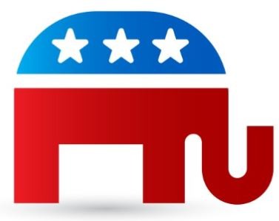
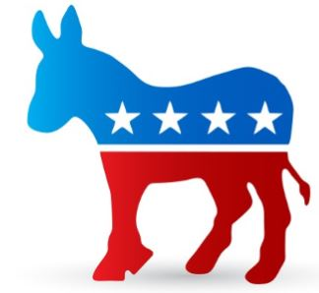
Key Election Dates in 2020
February 3 – Iowa Caucuses
March 3 – Super Tuesday
July – Democratic Convention (Milwaukee, WI)
August – Republican Convention (Charlotte, NC)
November 3 – ELECTION DAY!

Slide 24
Senate Battleground in 2020
Democratic-held Seat
Democratic-held seat – state won by Trump in 2016
Republican-held Seat
Republican-held seat – state won by Clinton in 2016
Wash.
Idaho
Maine
Mont.
Minn.
Ore.
N.D.
Vt.
Wis.
Mich.
N.Y.
N.H.
Wyo.
S.D.
Calif.
Mass.
Nev.
Neb.
Iowa
Pa.
R.I.
Utah
Ill.
Ind.
Ohio
N.J.
Conn.
Colo.
W.Va.
Md.
Kan.
Va.
Del.
Ky.
Source: U.S. Senate; Bloomberg Government
Note: Georgia has one regularly scheduled election and one special election; Arizona has a special election
Ariz.*
Mo.
N.C.
Va.
N.M.
Okla.
Tenn.
Texas
Ark.
S.C.
Miss.
Ala.
Ga.*
La.
Alaska
Fla.
Hawaii
Hawaii

Slide 25
Senate Outlook – FOR NOW
GOP currently holds a 53 – 47 majority; Dems will need to pick up at least 3-4 seats to take Majority
  Netting three seats would result in a tie and the majority would be decided by the vice president’s party; four seats would result in a Dem majority
Democrats defending 2 seats in states won by Trump (MI, AL)
Republicans defending 2 seats in states won by Clinton (ME, CO)
Major races to watch include Alabama, Georgia with 2 seats up, Colorado, Arizona, Iowa, Michigan and Maine
Outcome could impact current partisan split of the committees
  i.e., if Dems gain control GOP members will lose seats on committees of jurisdiction

Slide 26
Senate Races – The Big Picture
President Trump carried all but two of the states where GOP are defending Senate seats in 2020; he won 15 of those states by at least 14 percentage points
Senate Incumbents Up for Re-Election in 2020
Doug Jones (D-Ala.) | Dick Durbin (D-Ill.) | Cindy Hyde-Smith (R-Miss.) | Jack Reed (D-R.I.)
Dan Sullivan (R-Alaska) | Joni Ernst (R-Iowa) | Steve Daines (R-Mont.) | Lindsey Graham (R-S.C.)
Martha McSally (R-Ariz.) | Open (R-Kan.) | Ben Sasse (R-Neb.) | Mike Rounds (R-S.D.)
Tom Cotton (R-Ark.) | Mitch McConnell (R-Ky.) | Jeanne Shaheen (D-N.H.) | Open (R-Tenn.)
Cory Gardner (R-Colo.) | Bill Cassidy (R-La.) | Cory Booker (D-N.J.) | John Cornyn (R-Texas)
Chris Coons (D-Del.) | Susan Collins (R-Maine) | Open (D-N.M.) | Mark Warner (D-Va.)
Open (R-Ga.) | Ed Markey (D-Mass.) | Thom Tillis (R-N.C.) | Shelley Moore Capito (R-W.Va.)
David Perdue (R-Ga.) | Gary Peters (D-Mich.) | Jim Inhofe (R-Okla.) | Open (R-Wyo.)
Jim Risch (R-Idaho) | Tina Smith (D-Minn.) | Jeff Merkley (D-Ore.)
Notes: Pat Roberts (R-Kan.), Tom Udall (D-N.M.), Lamar Alexander (R-Tenn.) and Mike Enzi (R-Wyo.) are retiring; Johnny Isakson (R-Ga.) is resigning Dec. 31 and Georgia’s governor has yet to appoint a successor to serve through a November 2020 special election; McSally was appointed to fill the remainder of John McCain’s (R) term, a special election will occur in 2020 and the seat also will be on the ballot in 2022; Booker is up in 2020, but can simultaneously run for president and for re-election to the Senate

Slide 27
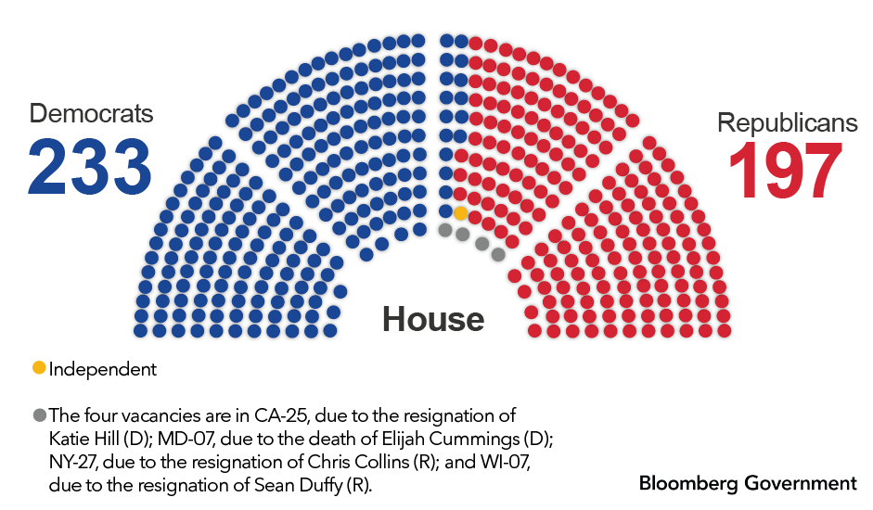
House Races – the Big Picture
All 435 House seats are up in 2020
Democrats are defending their majority after a net gain of 40 seats in 2018 election
Republicans would need to net around 18 seats to flip the chamber
Some of the most closely watched races will be districts won by the other party’s 2016 presidential candidate

Slide 28
House Races to Watch
NRCC Targets List
AZ-01 – Tom O’Halleran | GA-06 – Lucy McBath | NH-01 – Chris Pappas | OR-04 – Peter DeFazio
AZ-02 – Ann Kirkpatrick | IA-01 – Abby Finkenauer | NJ-02 – Jeff Van Drew | PA-07 – Susan Wild
CA-10 – Josh Harder | IA-02 – (Dave Loebsack, retiring) | NJ-03 – Andy Kim | PA-08 – Matt Cartwright
CA-21 – TJ Cox | IA-03 – Cindy Axne | NJ-05 – Josh Gottheimer | PA-17 – Conor Lamb
CA-25 – (Open, Katie Hill resigned) | IL-06 – Sean Casten | NJ-07 – Tom Malinowski | SC-01 – Joe Cunningham
CA-39 – Gil Cisneros | IL-14 – Lauren Underwood | NJ-11 – Mikie Sherrill | TX-07 – Lizzie Fletcher
CA-45 – Katie Porter | IL-17 – Cheri Bustos | NM-02 – Xochitl Torres Small | TX-32 – Colin Allred
CA-48 – Harley Rouda | KS-03 – Sharice Davids | NV-03 – Susie Lee | UT-04 – Ben McAdams
CA-49 – Mike Levin | ME-02 – Jared Golden | NV-04 – Steven Horsford | VA-02 – Elaine Luria
CO-06 – Jason Crow | MI-08 – Elissa Slotkin | NY-11 – Max Rose | VA-07 – Abigail Spanberger
FL-07 – Stephanie Murphy | MI-11 – Haley Stevens | NY-18 – Sean Patrick Maloney | VA-10 – Jennifer Wexton
FL-13 – Charlie Crist | MN-02 – Angie Craig | NY-19 – Antonio Delgado | WA-08 – Kim Schrier
FL-26 – Debbie Mucarsel-Powell | MN-03 – Dean Phillips | NY-22 – Anthony Brindisi | WI-03 – Ron Kind
FL-27 – Donna Shalala | MN-07 – Collin Peterson | OK-05 – Kendra Horn
Democrats that voted to impeach Trump will be targeted
Top targets also include the 31 Democrats in districts that voted for Trump in 2016 (underlined)

Slide 29
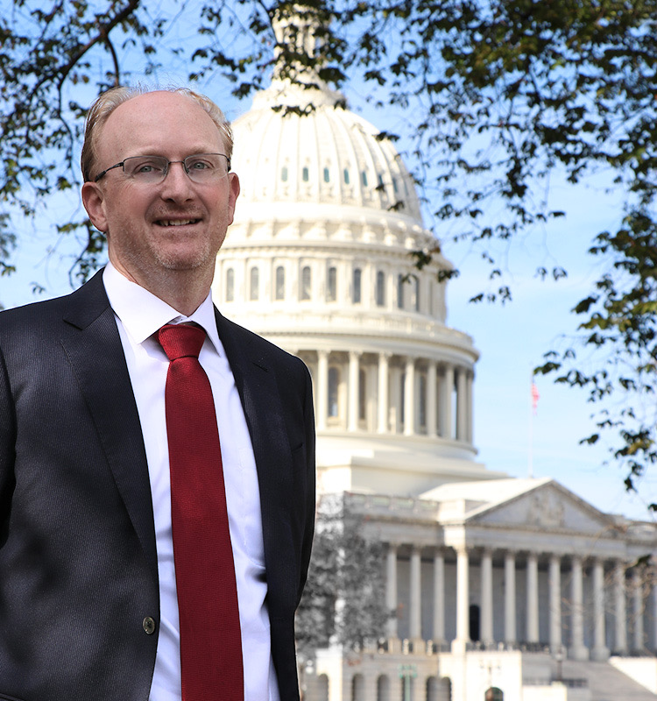
Travis Johnson
Travis Johnson
Principal
tjohnson@1607strategies.com
Direct: (202) 230-1203
www.1607strategies.com
Travis Johnson has 15 years of leadership experience on Capitol Hill working with prominent members of the House Financial Services Committee and Senate Banking Committee. Since 2016, he has worked with small to Fortune 500 companies and trade associations across banking and finance, insurance, and transportation. Throughout his career, Travis has demonstrated an ability to pass niche issues through a challenging political environment on Capitol Hill. He currently leads government affairs consulting firm 1607 Strategies.
Travis works with companies with traditional and unique business models on issues such as fintech, marketplace lending, cryptocurrency, payment systems, banking regulatory reform, financial services, tax, and securities. He also has experience with terrorism risk insurance, flood insurance, and corporate governance issues. Travis has extensive experience advocating for tax policy changes and banking regulatory reform in Congress, including the implementation of regulatory actions.
As a result of his years in Congress, Travis has extensive relationships in Congress, the administration, and with federal banking regulators. This includes but is not limited to the FDIC, SEC, Federal Reserve, CFTC, OCC, and Export-Import Bank.
Travis was Deputy Chief of Staff to a senior member of the Senate Banking Committee, David Vitter (R-LA) and formed a reputation of bringing together bipartisan partnerships to get things accomplished on Capitol Hill. In addition to his top position in the Senate, Travis also served former Rep. Tom Price (R-GA) handling a portfolio of top relevant issues of the day.

Slide 30

Susan Zook
Susan Zook
Principal
Mason Street Consulting, LLC
(202) 215-1936
susan@masonstreetllc.com
www.masonstreetllc.com
As principal at Mason Street Consulting, Susan is a leading authority in understanding the intersection of business development and health care policy. She has nearly two decades of experience developing and advancing health policy initiatives on Capitol Hill and working with companies to achieve their advocacy and business goals.
Prior to founding Mason Street Consulting, Susan served as health care policy advisor to Chairman Mike Crapo- senior member of the Senate Finance Committee. The Senator has been a leading voice and champion for both the Medicare Advantage program, and private sector innovation in the health care space. She also has worked for senior member of the House Energy and Commerce Committee.
​
Through her experience and network, Susan drives results for her clients, their partners, and the patients they serve. She has advised a wide range of health care stakeholders including heading the Government Affairs department for Fortune 500 insurance giant Aetna, as they navigated through the challenging ACA exchange environment and spearheaded one of the (then) largest health care mergers in nation’s history. She has represented hospitals, large multinational healthcare systems, commercial insurers, Medicare Advantage insurers, large health trade associations and small innovative startup health care companies.
Notes:
This should be Founder

